Slide 1
EMBT-ESE 4009
ESP32 Microcontroller interfacing Project topic:Health monitoring device using IOT -connected headphone.
Group Number : 2
Group Members:
Christy Rachel Philip
Fahad Rahman
James M. Chacko
Premil Prasannan
Instructor : Mike Aleshams
Presented by,
Fahad Rahman

Slide 2
Contents
Introduction
Overview of project
Engineering drawing
Block diagaram
About Esp32
Esp32 specifications
Esp32 interfacing
Conclusion

Slide 3
Introduction
This presentation is all about the specification and interfacing of Esp32 in Health monitoring device
ESP32 is a low-cost System on Chip (SoC) Microcontroller from Espressif Systems(is a Wi-Fi module that you see in many Smart devices for IOT) , the developers of the famous ESP8266 SoC. It is a successor to ESP8266 SoC and comes in both single-core and dual-core variations of the Tensilica's 32-bit Xtensa LX6 Microprocessor with integrated Wi-Fi and Bluetooth.

Slide 4
An Overview of the Project.
The topic of our project is “Health monitoring device using IOT-connected headphone.”
Our Project is an IoT-connected health care device, which is connected as a part of Bluetooth headphones. It consists of surface electrodes, temperature sensors, GPS, etc., to obtain various health-related data such as heartbeat rate, temperature, and EKG.
The device can be connected to a mobile phone through IoT. The user's information such as height, weight and previous history should be saved in the application. Using this, the family doctor can access it directly to monitor the patient's condition every day and communicate with them. Along with this, it has a push-button as well, so in case of emergencies, patient’s can press it by themselves and send information to 911 and doctor.

Slide 5
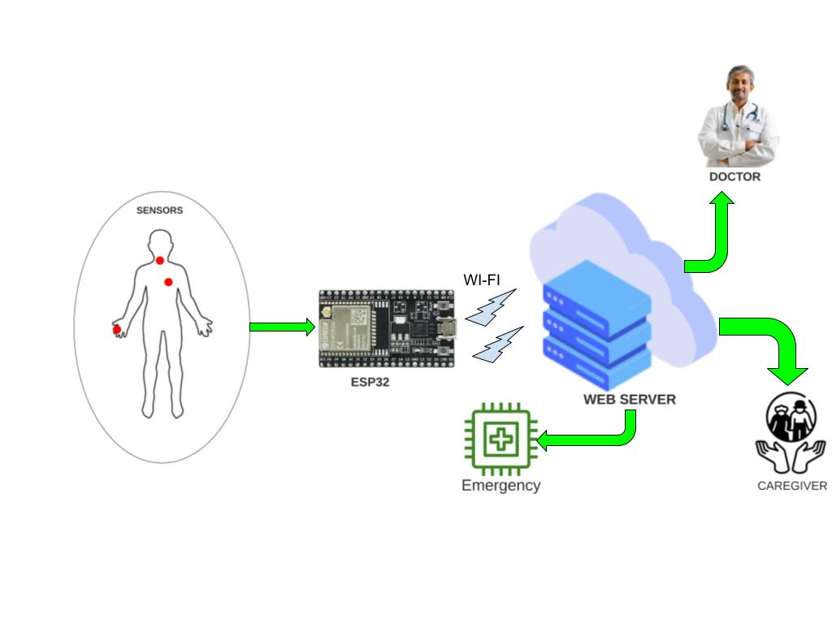
Engineering Drawing

Slide 6
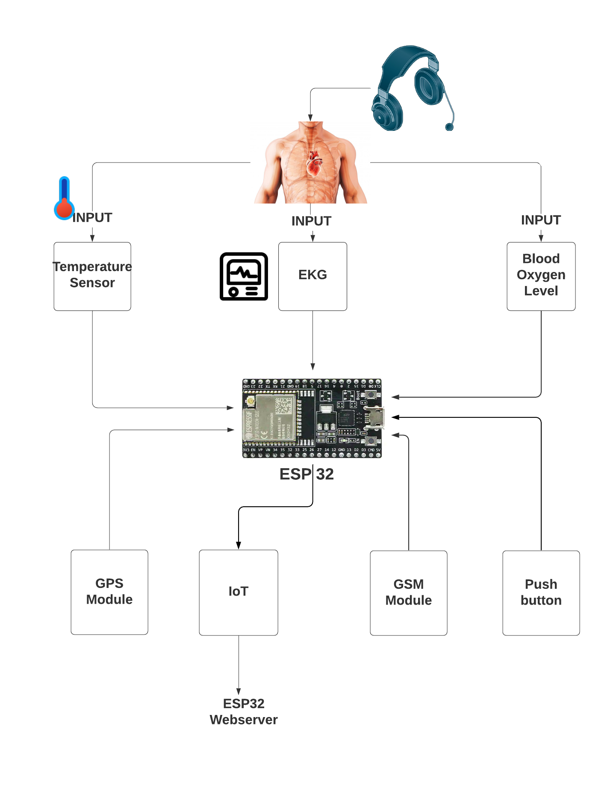
Block Diagram

Slide 7
ESP32 Microcontroller Board
The ESP32 is an updated version of the ESP8266. It offers both Bluetooth, GSM and WiFi modules in-built in it. It is faster and is available in a dual-core design. It is also capable of operating in an ultra-low-power mode, ideal for battery-powered applications.
The ESP32 is powered from a micro-USB connector. Plug a USB cable with micro-B plug into the micro-USB socket on the board and the other end into a PC USB port to power up the board. A regulator on the board supplies the ESP-WROOM-32 module with 3.3V derived from the USB 5V.

Slide 8
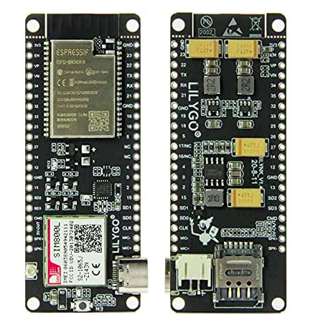
ESP32 Microcontroller Board
￼
￼
￼

Slide 9
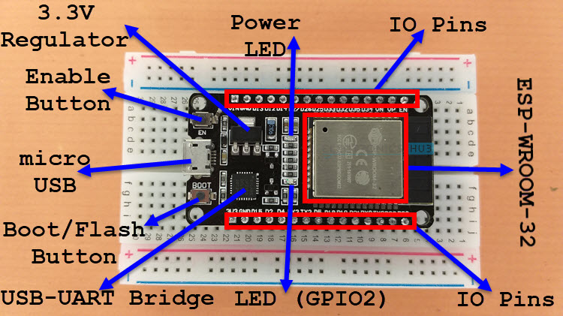
ESP32 Microcontroller Board
￼
￼
￼

Slide 10
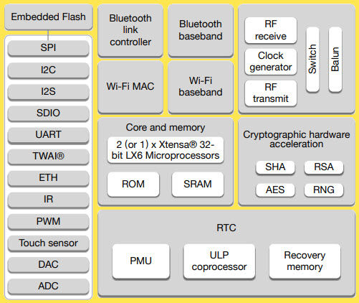
ESP32 Microcontroller Board
￼
￼
￼

Slide 11
ESP32 Microcontroller specification
Major features of ESP32
Wifi and Bluetooth: This one has an inbuilt wifi module, which helps to avoid an additional wifi module (Explore Embedded, n.d.)
Web Server: As ESP32 has its web server, we don’t need other web servers like AWS or Microsoft Azure. (Explore Embedded, n.d.)
Low power consumption: The ESP32-S2 co-processor is based on the RISC-V architecture. The power consumption is much lower. The ULP co-processor is active when the CPU is disabled in sleep modes and consumes a lot less power. (Explore Embedded, n.d.)
Cost-effective: The cost of this microcontroller is only $14.27, which makes it more cost-effective than Raspberry pi, which costs about $65.
ADC converter: The ESP32 integrates two 12-bit SAR (Successive Approximation Register) ADCs, supporting a total of 18 measurement channels. (Explore Embedded, n.d.)

Slide 12
ESP32 Microcontroller specification
Product Description
Chipset :ESPRESSIF-ESP32 240MHz Xtensa®(Xtensa is a configurable and extensible processor architecture that allows to define additional registers and instructions) single-/dual-core 32-bit LX6 microprocessor
FLASH : QSPI flash 4MB / PSRAM 8MB
SRAM 520 kB SRAM
Button Reset
USB to TTL CP2104 ( Logic-Level Serial Port converter )
Modular interface UART、SPI、

Slide 13
ESP32 Microcontroller specification
Product Description
On-board clock 40MHz crystal oscillator
Working voltage 2.7V-3.6V
Working current About 70mA
Sleep current About 1.1mA
SIM card Only supports Nano SIM card
Working temperature range -40℃ ~ +85℃
Size&Weight 78.83mm*28.92mm*8.06mm(11.77g)

Slide 14
ESP32 Microcontroller specification
Power Supply Specifications
Power Supply USB 5V/1A
Charging current 500mA
Battery 3.7V lithium battery
JST Connector 2Pin 1.25mm
USB Type-C

Slide 15
ESP32 Microcontroller specification
Wi-Fi
Standard FCC/CE-RED/IC/TELEC/KCC/SRRC/NCC
Protocol 802.11 b/g/n(802.11n，speed up to150Mbps)A-MPDU and A-MSDU polymerization，support 0.4μS Protection interval
Frequency range 2.4GHz~2.5GHz(2400M~2483.5M)
Transmit Power 22dBm
Communication distance 300m

Slide 16
ESP32 Microcontroller specification
Bluetooth
Protocol meet bluetooth v4.2BR/EDR and BLE standard
Radio frequency with -97dBm sensitivity NZIF receiver Class-1,Class-2&Class-3 emitter AFH
Audio frequency CVSD&SBC audio frequency

Slide 17
ESP32 Microcontroller specification
Software specification
Wi-Fi Mode Station/SoftAP/SoftAP+Station/P2P
Security mechanism WPA/WPA2/WPA2-Enterprise/WPS
Encryption Type AES/RSA/ECC/SHA
Firmware upgrade UART download/OTA（Through network/host to download and write firmware）
Software Development Support cloud server development /SDK for user firmware development
Networking protocol IPv4、IPv6、SSL、TCP/UDP/HTTP/FTP/MQTT
User Configuration AT + Instruction set, cloud server, android/iOSapp
OS FreeRTOS

Slide 18
ESP32 Microcontroller specification
Limitation Of ESP32
Being a powerful 32-bit microcontroller with integrated Wi-Fi, full TCP/IP stack for internet connection, and Bluetooth ESP32 have some limitations.
There is insufficient processing power for fast WiFi or CPU-intensive activities while using the WiFi, too few GPIOs, one ADC pin, and no onboard USB. The ESP8266 does not provide any means to secure the code or the data it stores. Anyone with physical access to the device can read your more sensitive information, such as Wi-Fi credentials. It also has less SRAM and ROM, but again it supports more prominent external memories.

Slide 19
ESP32 Microcontroller specification
Includes FreeRTOS
When your task is in the running state and performing its action, it is said to be in its Active State. When your task is not running or waiting for an event to occur, it is said to be in its Blocked State. What this means is, if there are 2 functions that both need to perform periodic tasks only one function can run at a time. This means that one function would be in the running state and the other would be in the blocked state. The components directory holds all the 'C' code for the ESP32. It contains all the components that make up the ESP32. It includes Drivers for numerous peripherals, the bootloader, bt(Bluetooth), freeRTOS. (Espressif, n.d.)
In our project, there will be four major tasks. At the same time, we need to take temperature, Heart rate and blood oxygen level. So these tasks will be performed at the same time and Esp32 supports multitasking. Moreover, the highest priority will be given to sending notifications. That is when the value from the sensor goes beyond a certain level the highest priority will be given to send alert messages and notifications.

Slide 20
ESP32 Microcontroller interfacing
In your Arduino IDE, go to File> Preferences
Enter https://dl.espressif.com/dl/package_esp32_index.json into the “Additional Board Manager URLs” field as shown in the figure below. Then, click the “OK” button:
Open the Boards Manager. Go to Tools > Board > Boards Manager
Search for ESP32 and press install button for the “ESP32 by Espressif Systems“
That’s it. It should be installed after a few seconds

Slide 21
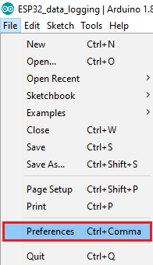
ESP32 Microcontroller interfacing

Slide 22
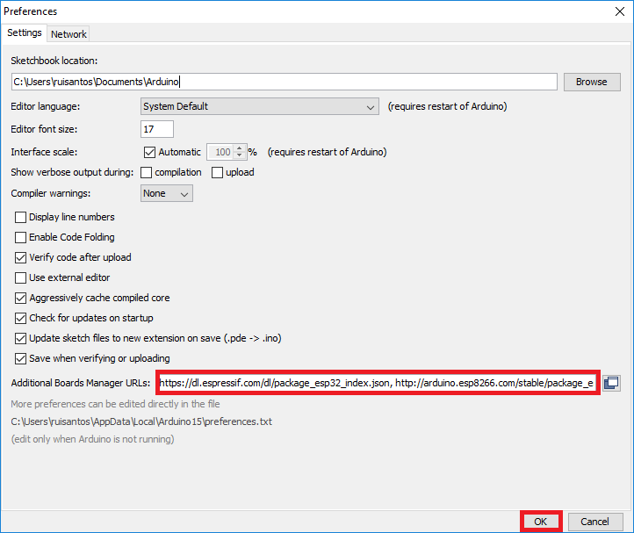
ESP32 Microcontroller interfacing

Slide 23
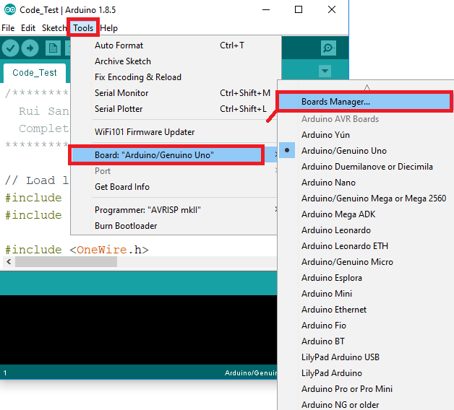
ESP32 Microcontroller interfacing

Slide 24
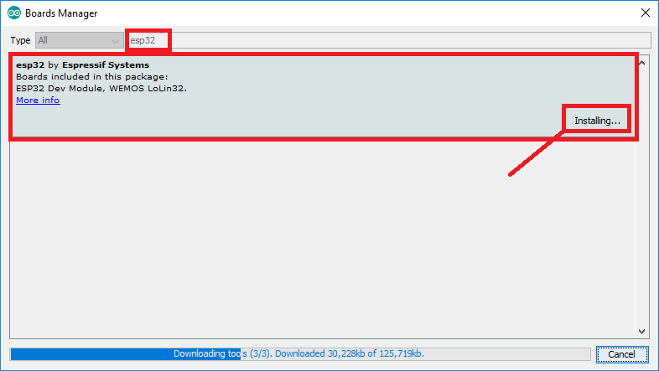
ESP32 Microcontroller interfacing

Slide 25
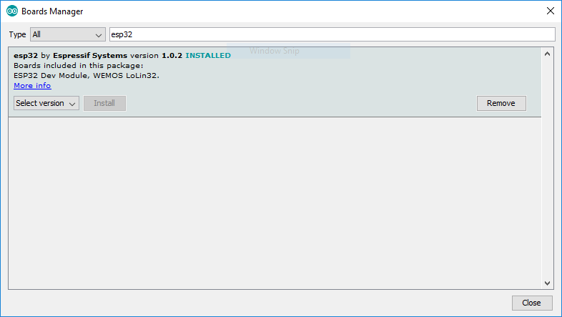
ESP32 Microcontroller interfacing

Slide 26
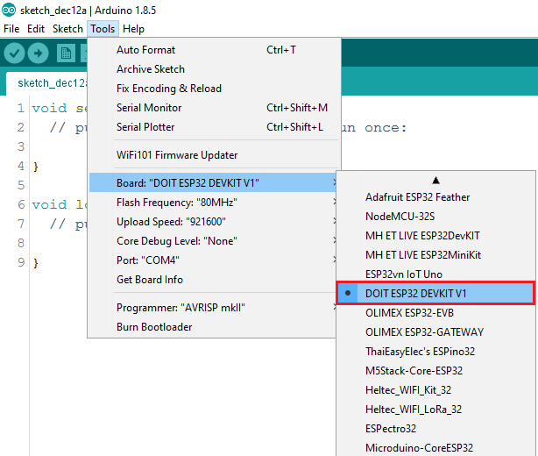
ESP32 Microcontroller interfacing

Slide 27
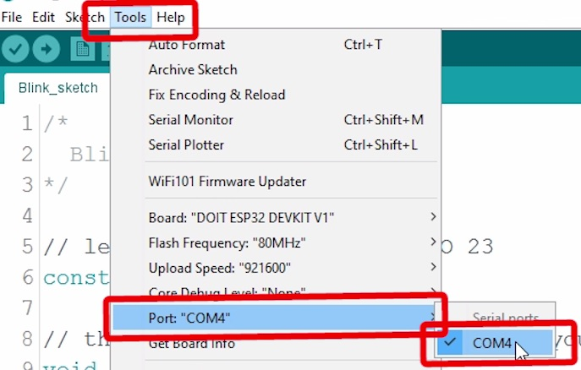
ESP32 Microcontroller interfacing

Slide 28
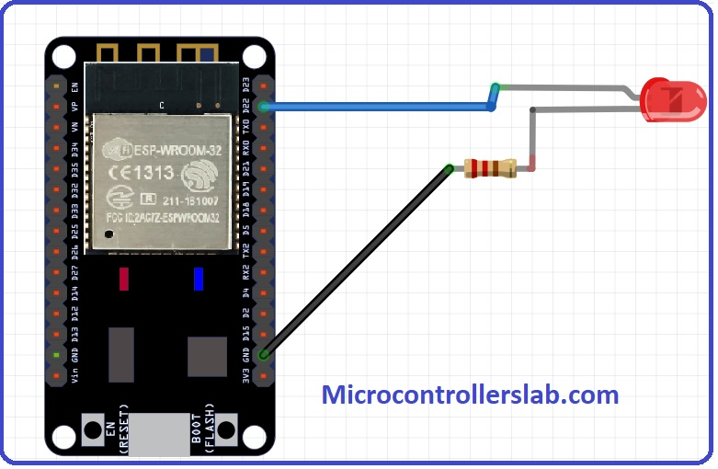
ESP32 Microcontroller circuit diagram of demo project blinking LED

Slide 29
ESP32 Microcontroller interface code OF demo project blinking LED
void setup()
{
pinMode(22, OUTPUT); // Set GPIO22 as digital output pin
}
void loop()
{
digitalWrite(22, HIGH); // Set GPIO22 active high
delay(1000); // delay of one second
digitalWrite(22, LOW); // Set GPIO22 active low
delay(1000); // delay of one second
}

Slide 30
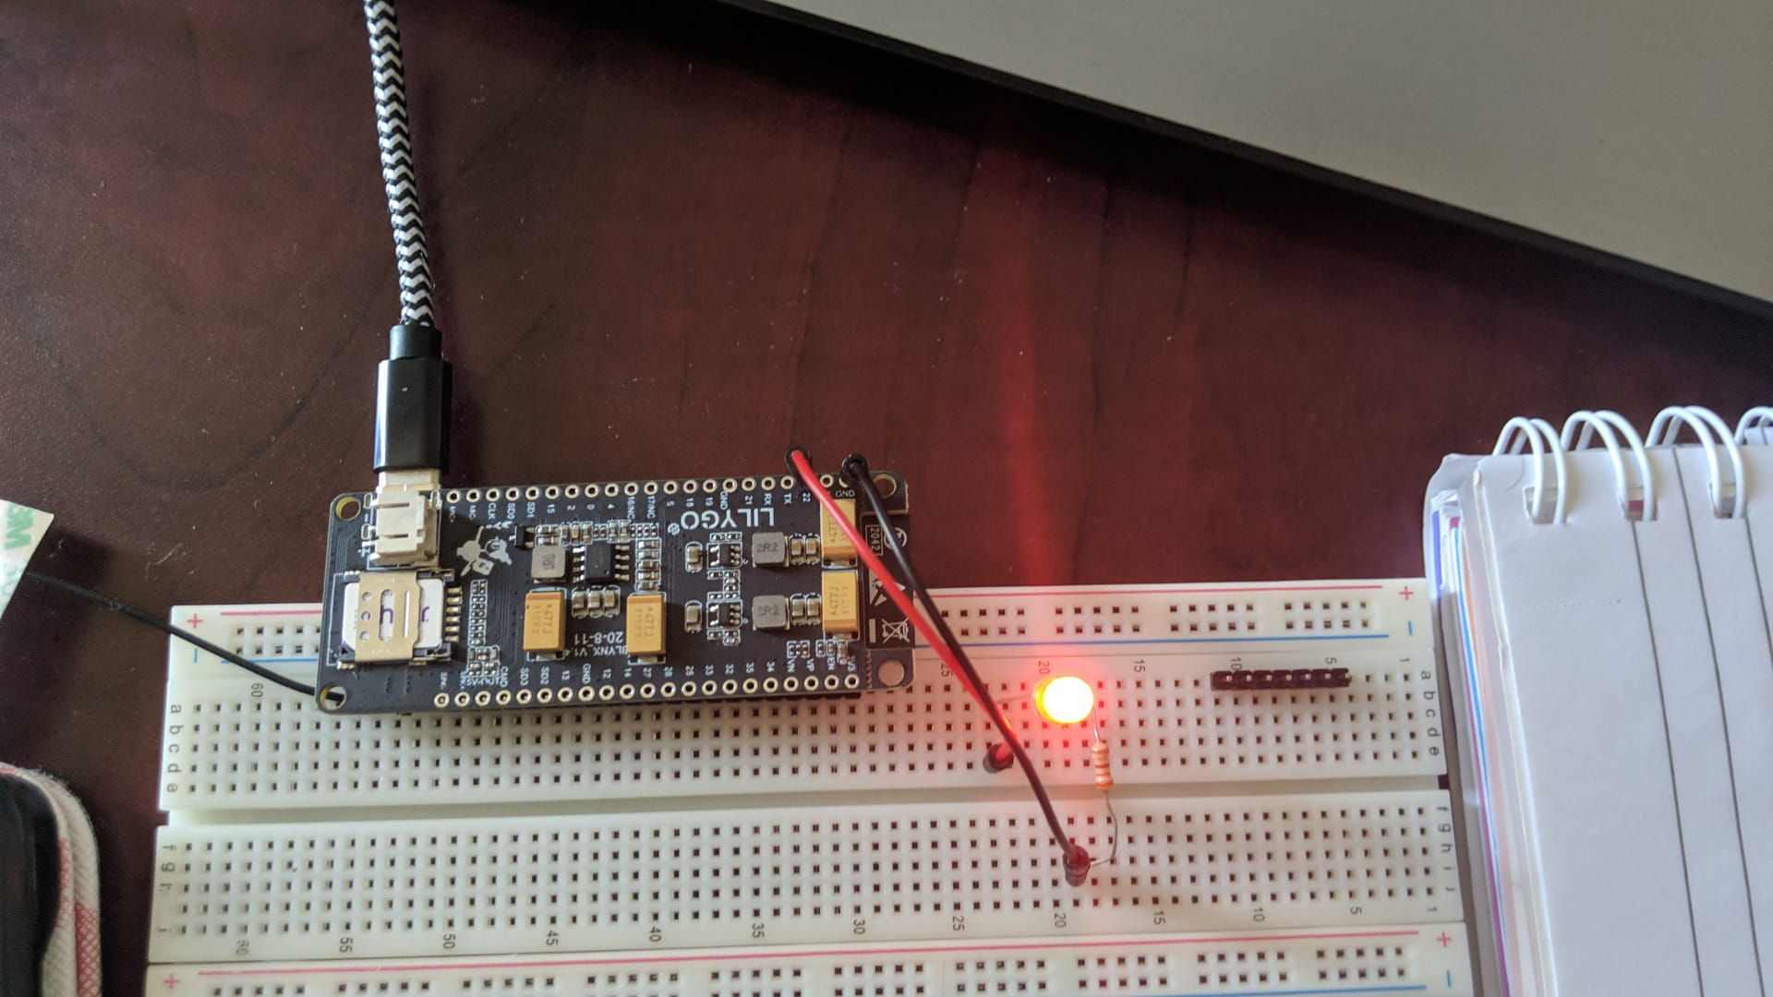
Blinking LED with ESP32 Microcontroller

Slide 31
Conclusion
In conclusion, in this presented we discussed the interfacing methods of the ESP32 Board, with an demo project

Slide 32
References.
Starting Electronics. (2017, September 21). ESP-WROOM-32 Testing and First Use of ESP32. https://startingelectronics.org/articles/ESP32-WROOM-testing/#:~:text=The%20first%20and%20most%20basic,on%2Dboard%20regulator%20is%20working
Random Nerd Tutorials. (n.d.).Introducing the TTGO T-Call ESP32 SIM800L. https://randomnerdtutorials.com/esp32-sim800l-publish-data-to-cloud/
Lingo Esp32 (n.d) specification . http://www.lilygo.cn/prod_view.aspx?TypeId=50044&Id=1127&FId=t3:50044:3
Random nerd tutorials https://randomnerdtutorials.com/installing-the-esp32-board-in-arduino-ide-windows-instructions/

Slide 33
Thank you

